Slide 1
Octopus Deploy
Phil Austin
phil_a10@hotmail.com

Slide 2
What is Octopus Deploy?
Deployment & release management tool
Can be part of DevOps toolset
No need to write deployment code for SQL stack
Easy to configure
Uses NuGet package format (www.nuget.org/)
Notes:
Deployment & release management tool
- popular with .NET folks
- supports huge range of technologies – including non-MS eg AWS, docker
- can support custom scripts eg Powershell
SQL Stack includes SSIS, SSAS, SSRS will demo with SSDT
NuGet
– anyone know it?
- standardised package management for .NET
DevOps
- strongly associated with automation
- sits in the space between dev and ops

Slide 3
Where does it fit?
Commit ‘code’
Build & unit test
Create release
Release to Test
Test
Release to Prod
Monitor

Slide 4
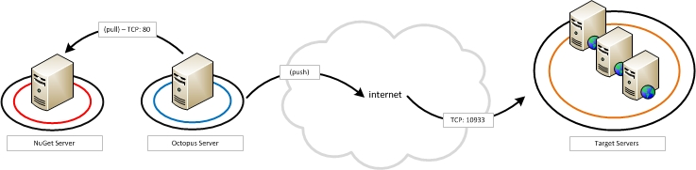
Architecture

Slide 5
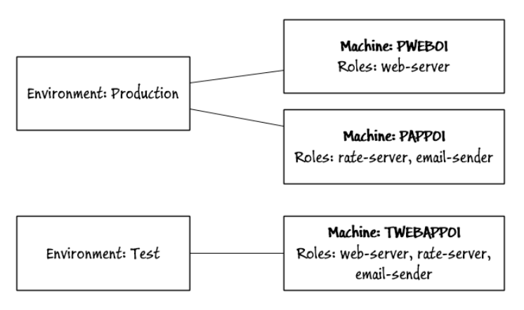
Octopus deploy concepts: Infrastructure
https://octopus.com/docs/key-concepts
Notes:
Each target is a machine.
A group of machines targeted by a deployment at the same time is an environment.
Each machine can also have a role – this enables you to configure Octopus to target certain release steps to apply to certain roles

Slide 6
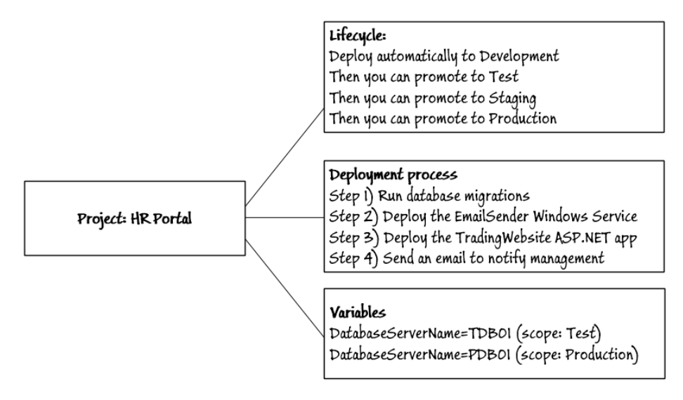
Octopus deploy concepts: Project/Lifecycle/Process
https://octopus.com/docs/key-concepts
Notes:
Lifecycle – rules governing what goes where when eg automatic (CI), scheduled, approved or manual
Deployment – takes place in configurable steps; including deployment of NuGet packages, custom scripts, sending email, pausing for manual intervention. Steps can be ordered and run conditionally
Variables – allows you to parameterise deployments

Slide 7
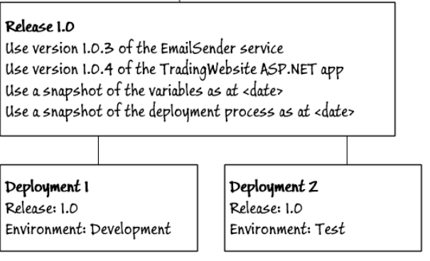
Octopus Deploy concepts: Release vs Deployment

Slide 8
Demo
End-to-end demo of deploying SSDT to SQL
Notes:
Open/show SSDT project
- ‘Hands-up who knows about/uses SSDT’
Now we need a deployable NuGet package. Run C:\Windows\Microsoft.NET\Framework\v4.0.30319\msbuild.exe "D:\Users\Phil.Austin\Documents\Bristol SQL UG\20171102\OctopusDeploy\OctopusDeploy.sln" /p:RunOctoPack=true /p:OctoPackPublishPackageToHttp=http://localhost/OctopusDeploy/nuget/packages /p:OctoPackPublishApiKey=API-VFKGAVZPWNTJHUIM7NYKRDJG /p:OctoPackPackageVersion=0.01
Now to configure Octopus. Configure the Environment first. Click the 'Environments' tab and give it a name that makes sense ie 'Development', 'Test' etc. Hit 'Save’
Add deployment targets to the environment. From the Environment created in 1 click the 'Add deployment target button’.
Run through deployment target options:
Listening Tentacle - recommended unless you are limited to making outbound connections from the installation machine.
Polling Tentacle – for cases where targets cannot accept inbound requests. Default port is 10943 – can be changed.
SSH – for *nix
Then add the name of the target server you installed the tentacle on in 2 and the port it is listening on (default is 10933). Then give the deployment target a name (ie 'Development - SQL') and a role ('Database'). Roles are a useful way of grouping targets and enable you to deploy to all roles within an environment. Hit 'Save’.
Create a Lifecycle – Library > Lifecycles > Add lifecycle. Add a phase targeting the environment created in 3.
Add a project (click the Projects tab)- this is the 'bucket' for the deployment and probably corresponds to a team project (ie 'GSTT') or maybe just a layer in the project stack (ie GSTT - Data).
After creating the project click ‘Choose a different lifecycle’ and choose the lifecycle created in 4.
Once the project is created you can start adding deployment steps. The first step needs to load the package loaded in step 5. Click Add step and choose 'Deploy a package'. Choose the appropriate role (ie 'Database') and in 'Package ID' the package name uploaded in 5. Lastly choose the default environment this should be deployed to. Hit 'Save’
Add steps you need to deploy the release.
From the 'community created step templates' choose 'SQL - Deploy DACPAC’.
DACPAC file name = OctopusDeploy.dacpac
Publish profile = OctopusDeploy.local.publish.xml (use the full filename with extension in both cases).
BUG: leave ‘Report’ and ‘Script’ options unticked if target db does not exist.
When choosing a login bear in mind local service accounts won't have access to SQL by default – use sa for demo.
Sa
!+password1
Make sure the 'Additional deployment contributor arguments' are left blank. Note that if you go back and alter these steps or add new ones you will have to create a new release as otherwise it will run the release using the old steps and/or settings.
Once you've added all of your steps you are ready to release. Releases can be triggered or started manually. To start a manual release click the 'Create release' button in the project page. At this point you can give the release a release number and add release notes and can change the release package used. Hit 'Save’
When ready click 'Deploy to <Environment name>' where <Environment name> is the default environment for the project. Click 'Deploy to...' to choose a different Environment.
Once you have chosen the environment, you get a 'Deploy now' button. Click this to release. Octopus will then deploy the project to the Environment as configured. Progress is supplied on the page indicating success or failure. NB a yellow triangle might indicate failure - so don't ignore it! Click on each step to see more details about the release.
To deploy automatically you need to set up a custom 'lifecycle'. Do this on the Library > Lifecycle page. From here click 'Add Lifecycle'. Give it a relevant name and description and then add a 'phase'. Then click 'Add environment' then select the relevant environment and then click the 'Deploy automatically to this environment as soon as the release enters this phase'. This will ensure that the ant project using this lifecycle will automatically deploy to this environment.
Then the lifecycle needs to be associated with the project. To do this navigate to the project created in step 8. and open the 'Process' page then click 'Choose a different lifecycle' and select the lifecycle option created in step 14.
Finally to ensure that the release is triggered when a package is pushed into Octopus Deploy open the 'Triggers' page from the Project page and click the 'Create a release when a package is pushed to the built-in package repository’.
Now we to deploy a NuGet package. Run
C:\Windows\Microsoft.NET\Framework\v4.0.30319\msbuild.exe "D:\Users\Phil.Austin\Documents\Bristol SQL UG\20171102\OctopusDeploy\OctopusDeploy.sln" /p:RunOctoPack=true /p:OctoPackPublishPackageToHttp=http://localhost/OctopusDeploy/nuget/packages /p:OctoPackPublishApiKey=API-VFKGAVZPWNTJHUIM7NYKRDJG /p:OctoPackPackageVersion=0.02

Slide 9
Pre-requisites
Windows Server 2008 SP2+, 2008 R2, 2012, 2012 R2 or 2016 ("Server with a GUI" install, not Server Core)
.NET Framework 4.5.1+ for Octopus Server 3.4.0 and later
SQL Server installed locally or on another server, or Microsoft Azure SQL Database
Hardware:
Absolute minimum to make it run: 512MB RAM, 1GHz CPU, 2GB free disk space
Recommended for smaller deployments (less than 30 Tentacles for example): 2GB RAM, dual-core CPU, 10GB free disk space
Recommended for larger deployments: 4GB RAM, dual-core, 20GB free disk space
NuGet

Slide 10
Licensing
‘Freemium’ model
Limit of 5 projects/10 machines/5 users
$700 ‘Pro’ license 20 users/projects/machines
Other editions offer more scale

Slide 11
Architecture
There are a few parts to an Octopus server:
A SQL Server database – including Express Edition
A Windows service
Octopus Manager
Octopus tentacle

